Slide 1

IOD Capstone Project - Jun 2022
By Lim Chee Wai
Date 4 Jun 2022

Slide 2
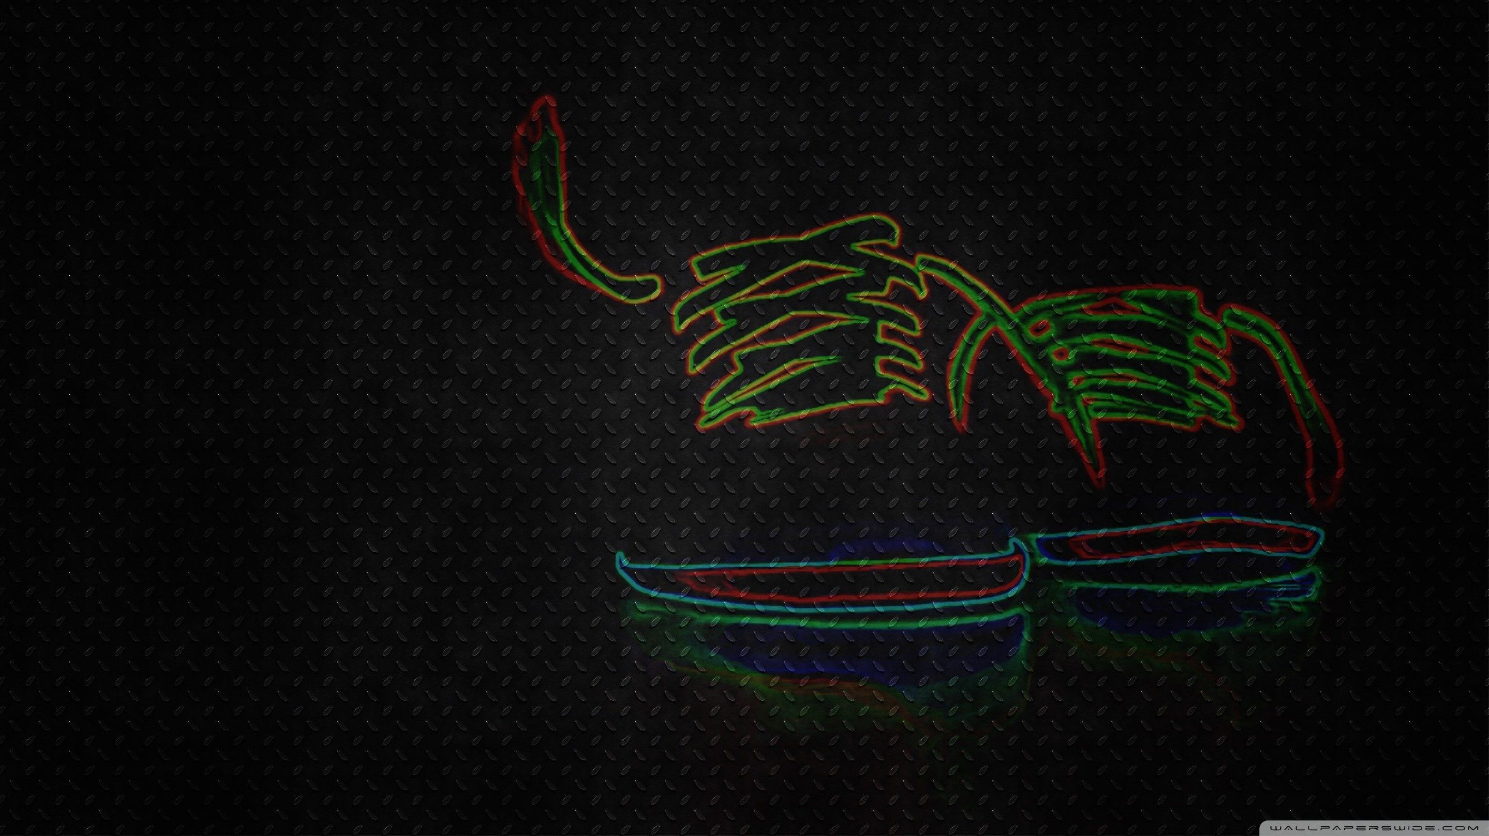
Can your Hobby really become an alternative investment?
Topic

Slide 3
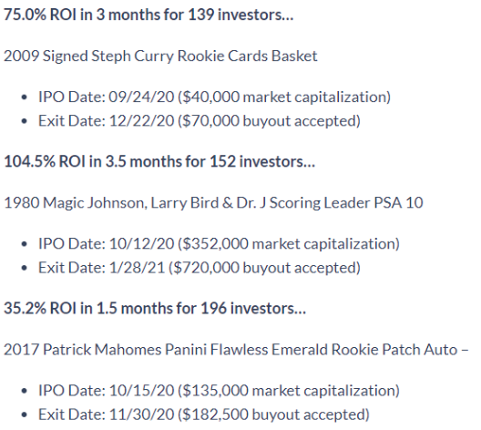
Background
Secondary sneakers have blossomed into a $2 billion/year industry
Early forecasts suggest this number may triple to $6 billion in the next 4 years
StockX believes the global resale market will be a monstrous $30 – $40 billion within 10 years.
Source: https://alts.co/investing-in-sneakers/

Slide 4
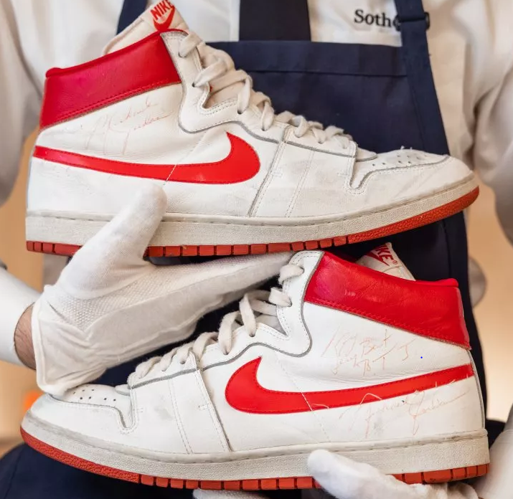
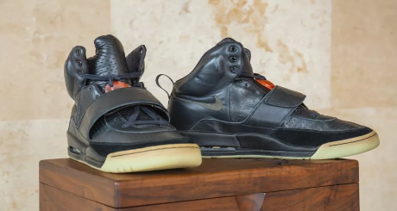
WAAAAH Moment!
Nike Airship game-worn by Michael Jordan in 1984, Collector Nick Fiorella paid $1.47 million for them at Sotheby's Las Vegas on 24 October, 2021.
Kanye West Nike Air Yeezy Grammy Prototype from 2008, sold for $1.8 million via private sale on 26 April, 2021
Source: https://www.newsweek.com/most-expensive-pairs-sneakers-ever-sold-michael-jordan-kanye-west-nike-1644248

Slide 5
6 points to take note
Brand
Limited editions
Collaborations
Unique design
Condition
Hype

Slide 6
Problems
Some people do not believe in turn your hobby into investment thing
Some people believe sneaker investment is a scam
Some people doubts if sneaker investment really generate profit to them

Slide 7
Target Audience
People who curious about sneaker investment
People who doubts about sneaker investment
People who want to start sneaker investment

Slide 8
Why We Doing This
To investigate if sneaker investment really an investment
To prove Hobby is more than just hobby
Anything can be investment
Inspire people to think differently, think out of the box

Slide 9
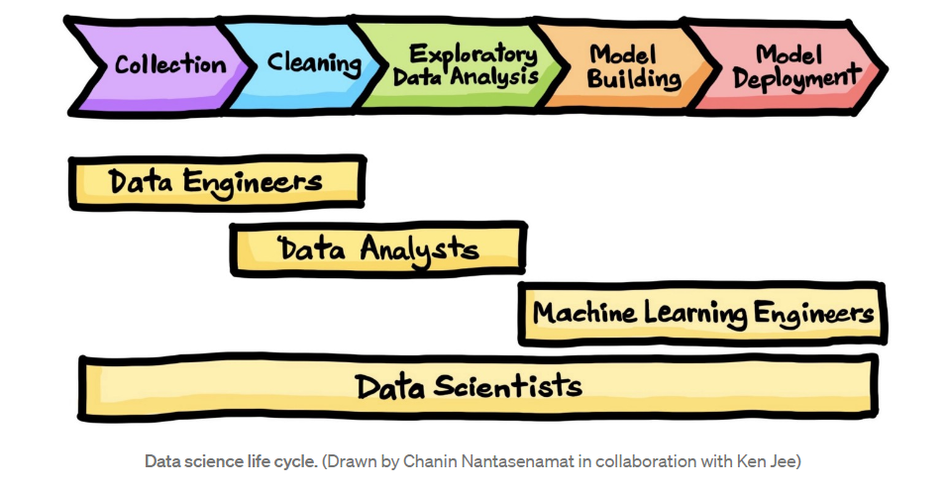
Data Science Proccess

Slide 10
About Dataset
This dataset is from the Kaggle StockX 2019 Data Contest.
Contains data ranging from 1 September 2017 to 13 February 2019.
This dataset contain 99956 rows and 8 columns

Slide 11
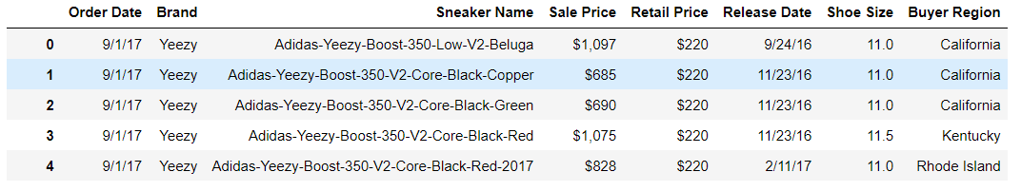
Quickview on Original Dataset

Slide 12
Steps
Sourcing for Dataset
Data Cleaning - Convert NECESSARY Feactures to NUMERICAL figures
Double check and make sure it worked
Modeling the Dataset

Slide 13
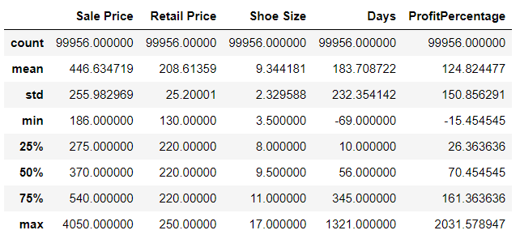
Main Feactures

Slide 14
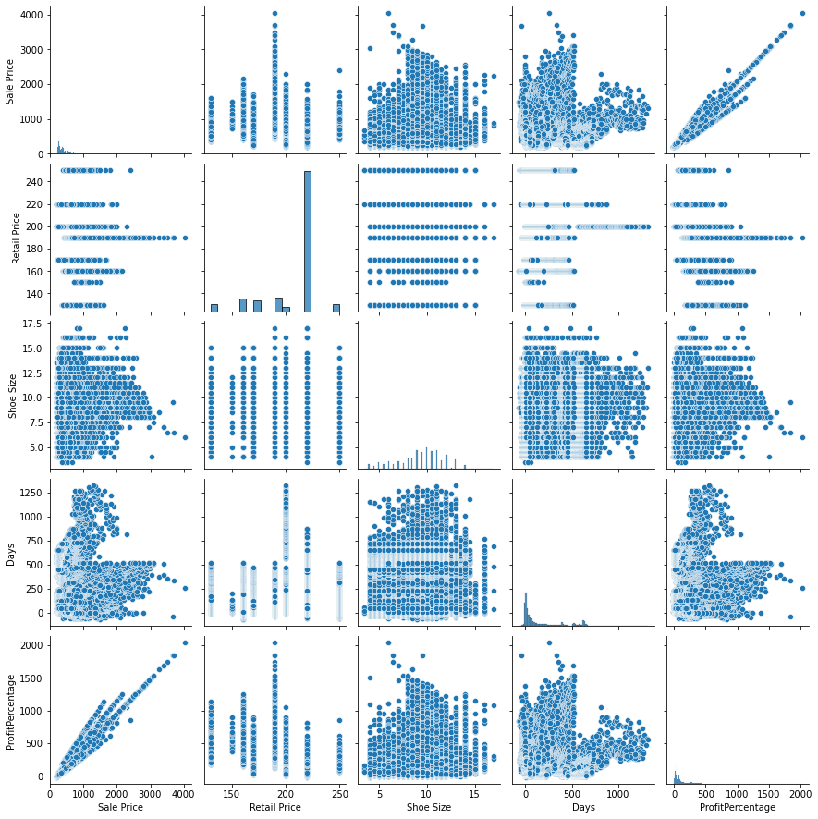
Graph - 1
SNS Pairplot

Slide 15
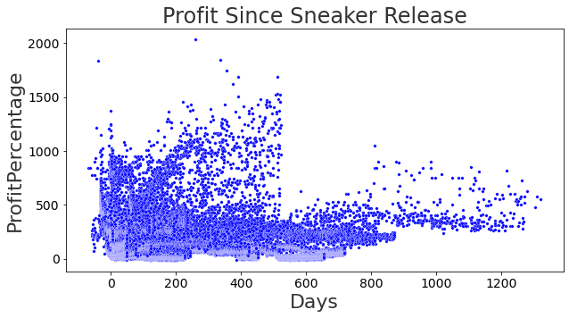
Graph - 2

Slide 16
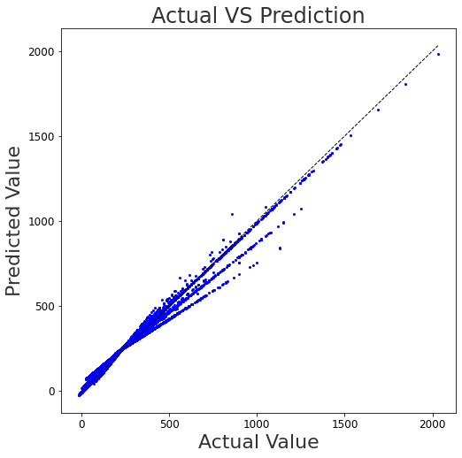
Prediction - 1

Slide 17
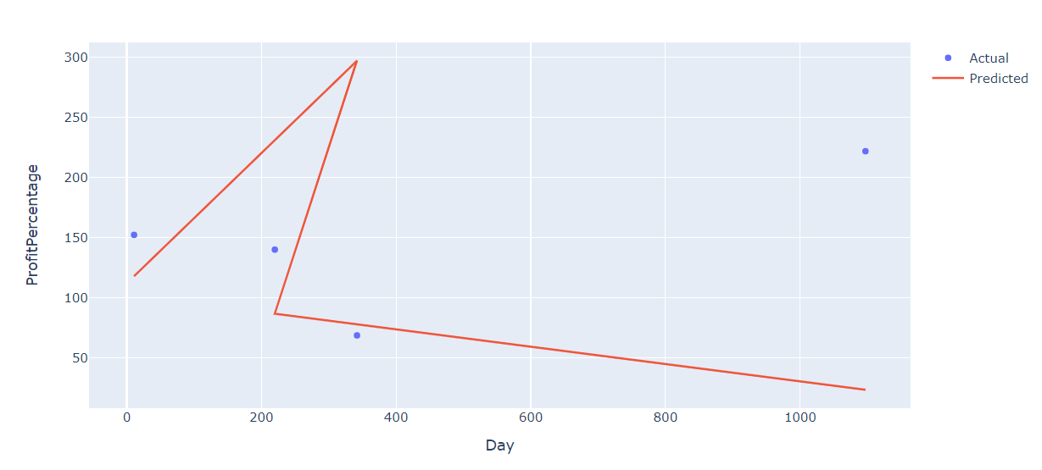
Prediction - 2

Slide 18
Conclusion
Sneaker Investment return good Profit
People need to judge when is the right timing to sell the sneaker in order to maximize the profit
Sneaker brand, model and style play very important role
Future Work to improve: Try more different ML with more different feactures

Slide 19
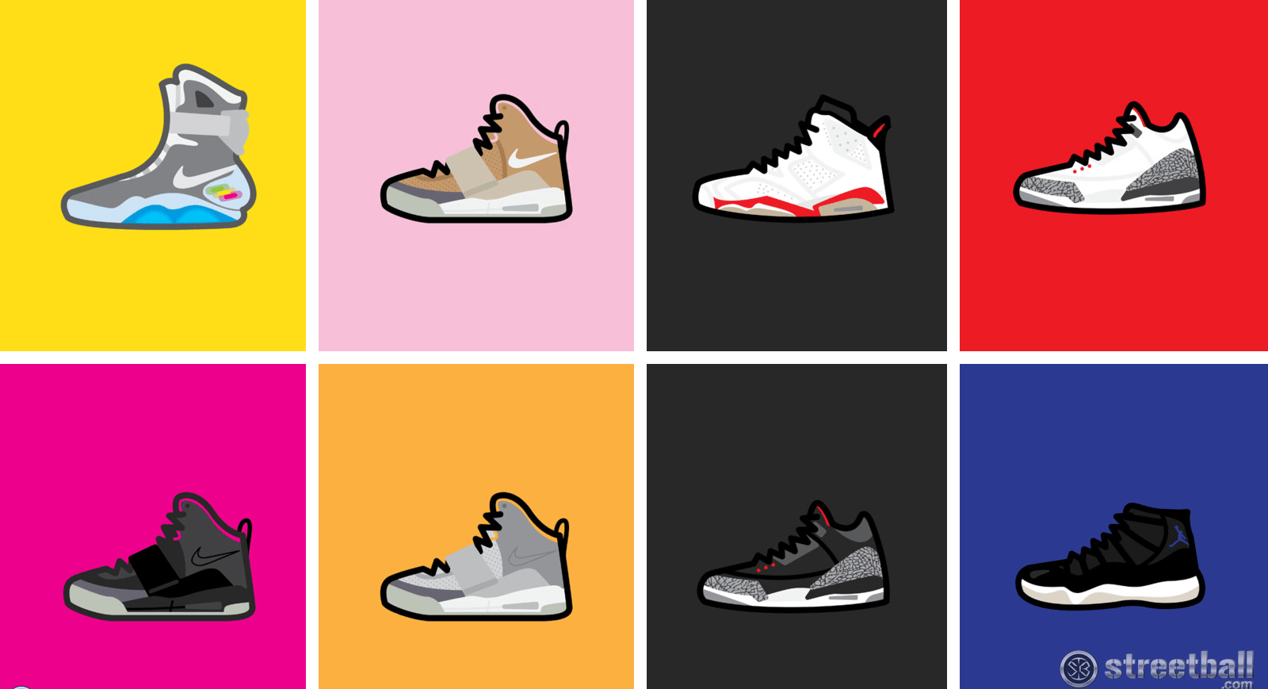
The End!
THANK YOU so much for your time!

Slide 20
Question?

